Slide 1
NS2

Slide 2
Ns2
Generally speaking, a network simulator is a dedicated software that allows to:
Model the behaviour of network protocols/applications (e.g. TCP protocol).
Reproduce the behaviour of a computer network as a whole (e.g. a wireless LAN).
Quantify the network performance, through well-defined network metrics (e.g. system throughput).

Slide 3
Ns2: WHEN
Started as a project in 1989
ns-1 by Floyd and McCanne at Lawrance Berkeley National Laboratory (LBNL).
ns-2 by Steve McCanne, within the VINT project involving a consortium of US universities (LBL, PARC,USC, ...)
currently maintained at USC/ISI (University of Southern California), but several forks available.
NS3 relased in 2008 (now NS3.15)
Deployed by a team lead by Tom Henderson and Sally Floyd (University of Washington)
A completely new tool, not a mere extension of Ns2 !

Slide 4
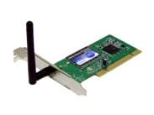

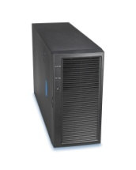
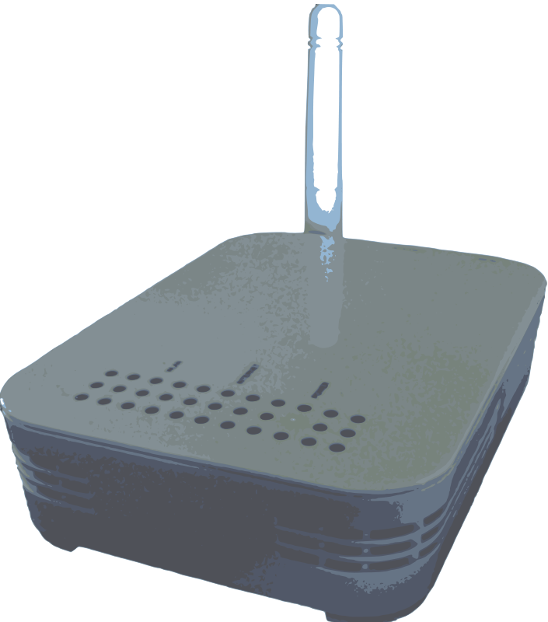

Ns2:
Link Models:
Wired Links,
Wireless Links,
Satellite Links, …
Application Layer
FTP, Telnet, HTTP, Multimedia, Exponential traffic, …
Transport Layer
UDP, TCP (Reno, NewReno, Vegas, SACK), …
Network Layer
Wired routing (RIP), Ad Hoc Routing (AODV, OLSR, DSR), …
MAC Layer
Ethernet, 802.11 (WIFI), 802.15.4, Bluetooth, 802.16 (WIMAX), …

Slide 5
ns Directory Structure
ns-allinone
Tcl8.0
TK8.0
OTcl
tclcl
ns-2
nam-1
tcl
...
C++ code
ex
test
lib
mcast
...
examples
validation tests
OTcl code
simple.tcl

Slide 6
NS-2 Environment
Simulation Scenario
1
2
set ns_ [new Simulator]
set node_(0) [$ns_ node]
set node_(1) [$ns_ node]
Tcl Script
C++ Implementation
class MobileNode : public Node
{
friend class PositionHandler;
public:
MobileNode();
•
•
}

Slide 7
NS-2 : C++ / OTCL
NS-2 Code contains two sets of languages, namely C++ and OTcl.
C++ is used for the creation of objects because of speed and efficiency.
OTcl is used as a front-end to setup the simulator, configure objects and schedule events because of its ease of use.

Slide 8
Why two languages? (Tcl & C++)
C++: Detailed protocol simulations require systems programming language
byte manipulation, packet processing, algorithm implementation
Run time speed is important
Turn around time is slower
Tcl: Simulation of slightly varying parameters or configurations
quickly exploring a number of scenarios
iteration time (change the model and re-run) is more important

Slide 9
Tcl or C++?
Tcl
Simple Configuration, Setup, Scenario
If it’s something that can be done without modifying existing Tcl module.
C++
Anything that requires processing each packet
Needs to change behavior of existing module

Slide 10
Ns2: OTCL inside
OTCL Overview
Assign a value to a variable
set x 0
Keyword $ returns the value of a variable
set y $x
Selection Statements if (if < expr > ... else ...)
if {$x == $y } { puts “Hello world” }
Iterative Statements
for {set i 0; $i < $x ; incr i}{puts “Hello world” }
Function Declaration
proc name_FUNCTION {par1, ...parn} {... return $x}

Slide 11
Ns2: Building the network (WIRED)
Define the nodes of the network
set n0 [$ns node]
set n1 [$ns node]
Define the Links among nodes
#Nodes connected with an Ethernet cable, 10 Mb/s
$ns duplex-link $n0 $n1 10Mb 100ms DropTail
Specifies bandwidth, delay, and queue policy:
DropTail, RED, CBQ, FQ, SFQ, DRR

Slide 12
Ns2: Building the network (WIRED)
Define the error model on wired links
set loss_module [new ErrorModel]
$loss_module set rate_ 0.1
$loss_module ranvar [new RandomVariable/Uniform]
$loss_module drop-target [new Agent/Null]
$ns lossmodel $loss_module $n0 $n1
Lossy link between node 0 and node 1, with
error rate equal to 0.1. Packets with errors are sent
to Agent/Null, i.e. they are discarded.

Slide 13
Ns2: Building the network (WIRED)
Define the nodes of the network
set n0 [$ns node]
set n1 [$ns node]
Define the position
set topograpy [new Topography]
$topography load_flatgrid 400 400
Define the position
$n0 set X_ 300
$n0 set Y_ 400
$n0 set Z_ 0
Set simulation area
to 400mx400m
Set node 0 at position <300,400,0>

Slide 14
Ns2: Building the network
Define the mobility of wireless nodes
NS_OBJ at TIME “NODE setdest X_COOR Y_COOR SPEED”
$ns at 10.5 “$node(0) setdest 100 100 5.0”
At time 10.5, node 0 will move toward
position (100,100) with speed equal to
5 m/s (constant speed)
Utilize the General Object Director (GOD)
set $god [new God]
Object that stores global information
about the state of the environment (e.g.
the matrix of connectivity among nodes)

Slide 15
Ns2: HOW
Running an OTCL script:
ns script-file.tcl [parameters]
Initialize the scheduler
Define the simulation parameters (e.g. start time)
Build the network topology
Generate the traffic load
OTCL → scripting language, OO-extension of TCL →

Slide 16
Ns2: Creating connections (UDP/TCP)
Define the end-points of the communication
TCP Connections:
set src [new Agent/TCP]
set dst [new Agent/TCPSink]
UDP Connections:
set src [new Agent/UDP]
set dst [new Agent/Null]
Connect sender and receiver
$ns attach-agent $n0 $src
$ns attach-agent $n1 $dst
$ns connect $src $dst

Slide 17
Ns2: Attaching Applications
Define the application and attach it to the sender
FTP Agent
set ftp [new Application/FTP]
$ftp attach-agent $src
$ns at TIME “$ftp start”
CBR Agent
set cbr [new Application/Traffic/CBR]
$cbr attach-agent $src
$ns at TIME “$cbr start”
Exponential Traffic Generator
set exp [new Application/Traffic/Exponential]

Slide 18
Ns2: Simulation Output (TRACE)
The output of the simulation is a trace file, containing the description of the events occurred during the simulation.
s 10.00000 0 MAC --- 0 RTS 44 [253e 1 0 0]
r 10.00041 1 MAC --- 0 RTS 44 [253e 1 0 0]
s 10.00042 1 MAC --- 0 CTS 38 [2404 0 0 0]
r 10.00075 0 MAC --- 0 CTS 38 [2404 0 0 0]
s 10.00076 0 MAC --- 100 cbr 1112 [13a 1 0 800]
r 10.00982 1 MAC --- 100 cbr 1112 [13a 1 0 800]
Simulation
Time
Node
Traffic
type
Packet
size
MAC Header
Packet
ID
Event Type

Slide 19
Wireless Network!

Slide 20
Define Options
set val(chan) Channel/WirelessChannel ;# channel type
set val(prop) Propagation/TwoRayGround ;# radio-propagation model
set val(netif) Phy/WirelessPhy ;# network interface type
set val(mac) Mac/802_11 ;# MAC type
set val(ifq) Queue/DropTail/PriQueue ;# interface queue type
set val(ll) LL ;# link layer type
set val(ant) Antenna/OmniAntenna ;# antenna model
set val(ifqlen) 50 ;# max packet in ifq
set val(nn) 2 ;# number of mobilenodes
set val(rp) DSDV ;# routing protocol

Slide 21
Initialize Global Variables
set ns_ [new Simulator]
set tracefd [open simple.tr w]
$ns_ trace-all $tracefd
#Open the NAM trace file
set file2 [open out.nam w]
$ns_ namtrace-all $file2

Slide 22
Define a 'finish' procedure
proc finish {} {
global ns_ file1 file2 tracefd
$ns_ flush-trace
close $tracefd
close $file2
exec nam out.nam &
exit 0

Slide 23
Set up topography object
# set up topography object
set topo [new Topography]
$topo load_flatgrid 500 500
#
# Create God
#
create-god $val(nn)

Slide 24
Configure Node
$ns_ node-config -adhocRouting $val(rp) \
-llType $val(ll) \
-macType $val(mac) \
-ifqType $val(ifq) \
-ifqLen $val(ifqlen) \
-antType $val(ant) \
-propType $val(prop) \
-phyType $val(netif) \
-channelType $val(chan) \
-topoInstance $topo \
-agentTrace ON \
-routerTrace ON \
-macTrace OFF \
-movementTrace OFF

Slide 25
for {set i 0} {$i < $val(nn) } {incr i} {
set node_($i) [$ns_ node]
$node_($i) random-motion 0 ;# disable random motion
}

Slide 26
Provide initial (X,Y, for now Z=0) co-ordinates for mobilenodes
#
$node_(0) set X_ 5.0
$node_(0) set Y_ 2.0
$node_(0) set Z_ 0.0
$node_(1) set X_ 390.0
$node_(1) set Y_ 385.0
$node_(1) set Z_ 0.0

Slide 27
Producing movements
# Node_(1) starts to move towards node_(0)
#
$ns_ at 50.0 "$node_(1) setdest 25.0 20.0 15.0"
$ns_ at 10.0 "$node_(0) setdest 20.0 18.0 1.0"
# Node_(1) then starts to move away from node_(0)
$ns_ at 100.0 "$node_(1) setdest 490.0 480.0 15.0"

Slide 28
Setup traffic flow between nodes
# Setup traffic flow between nodes
# TCP connections between node_(0) and node_(1)
set tcp [new Agent/TCP]
$tcp set class_ 2
set sink [new Agent/TCPSink]
$ns_ attach-agent $node_(0) $tcp
$ns_ attach-agent $node_(1) $sink
$ns_ connect $tcp $sink
set ftp [new Application/FTP]
$ftp attach-agent $tcp
$ns_ at 10.0 "$ftp start"

Slide 29
# Tell nodes when the simulation ends
#
for {set i 0} {$i < $val(nn) } {incr i} {
$ns_ at 150.0 "$node_($i) reset";
}
$ns_ at 150.0 "stop"
$ns_ at 150.01 "puts \"NS EXITING...\" ; $ns_ halt"
proc stop {} {
global ns_ tracefd
$ns_ flush-trace
close $tracefd
}

Slide 30
puts "Starting Simulation..."
$ns_ at 125.0 "finish"
$ns_ run

Slide 31
Thank You

